Slide 1

Introduction to SLE
Systemic Lupus Erythematosus (SLE) = autoimmune disease
Immune complex mediated → complement activation
Female : Male ≈ 9 : 1
Associated with HLA B9,DR2,DR3

Slide 2
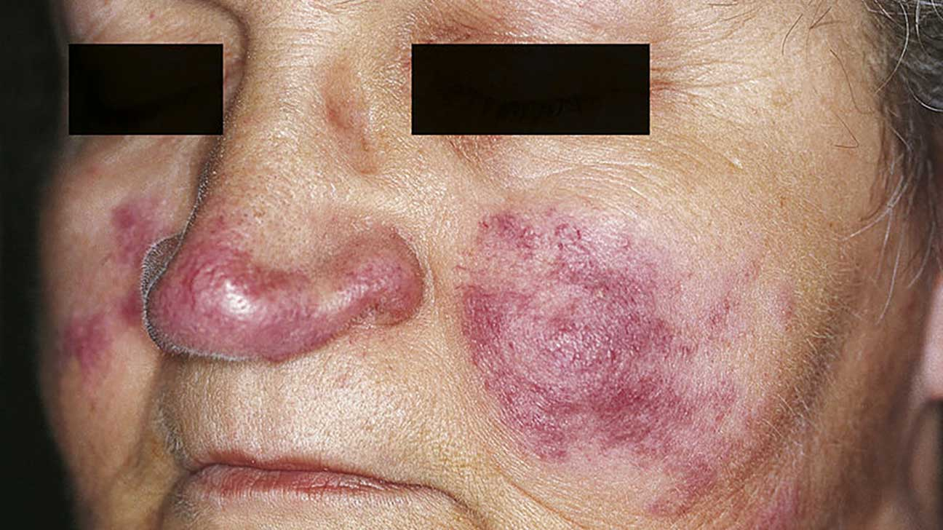
Diagnosis
No single confirmatory test
Diagnosis = ≥4 of 11 ACR criteria
: MD SOAP BRAIN
• Malar rash
• Discoid rash
• Serositis
• Oral ulcers
• Arthritis
• Photosensitivity
• Blood disorders (anemia, thrombocytopenia, leukopenia)
• Renal disorder
• ANA
• Immunologic (dsDNA, Smith, Histone Abs)
• Neurologic (seizures, psychosis)

Slide 3
Clinical Presentation
            Common symptoms:
• Serositis (chest pain)
• Arthritis (large joints) (Morning stiffness)
• Rashes → malar (butterfly), discoid, photosensitivity
And alopecia
            Serious manifestations:
• Cerebritis (encephalopathy, psychosis, seizures)
• Lupus nephritis → progressive renal failure
• Pulmonary hemorrhage
• Libman-Sacks endocarditis )sterile vegetation (
And pericarditis -> most common cardiological manifestation in SLE.

Slide 4
Investigations
Comment | Test
Sensitive, not specific | ANA
Specific, correlates with nephritis | Anti-dsDNA
highly specific | Anti-Smith
Drug-induced lupus | Anti-Histone
Sign of active SLE | ↓ CRP , C3 and C4 High ESR
• if nephritis suspected | Renal biopsy

Slide 5
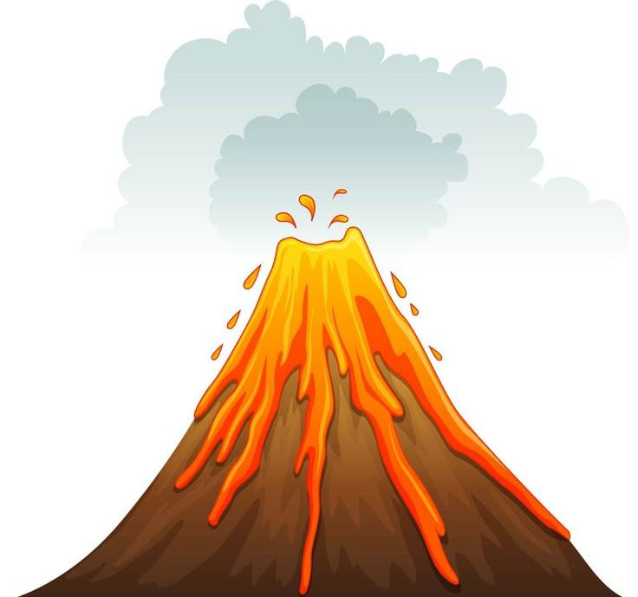
Drugs induses SLE
Procainamide ) the most common one (
Hydralazine ( the second most common one (
Investigation
anti histon antibody is the most appropriate test

Slide 6

Treatment
• Hydroxychloroquine → for all patients
• NSAIDs → symptom control (arthralgia)
• Steroids → for flares
• Cyclophosphamide IV / Mycophenolate → severe disease (nephritis, cerebritis)
• Methotrexate → 2nd line after hydroxychloroquine

Slide 7
Case Scenario
A 25-year-old female patient comes to your clinic .She complains of : fatigue and pain in her small joints (hands and wrists), especially in the morning.
She also reports that her face develops a rash after sun exposure, and she has mouth ulcers and hair loss.🩺
Examination: Malar rash, non-erosive arthritis in small joints, mild alopecia
🧪 Investigations: CBC → mild anemia, leukopenia
ANA → Positive, Anti-dsDNA → Positive,
Urine → Proteinuria

